Slide 1
Technological challenges and roadmap for flexible heaters
5th SPACE PASSIVE COMPONENT DAYS - SPCD 2024
15-18 October 2024 | ESA/ESTEC

Slide 2
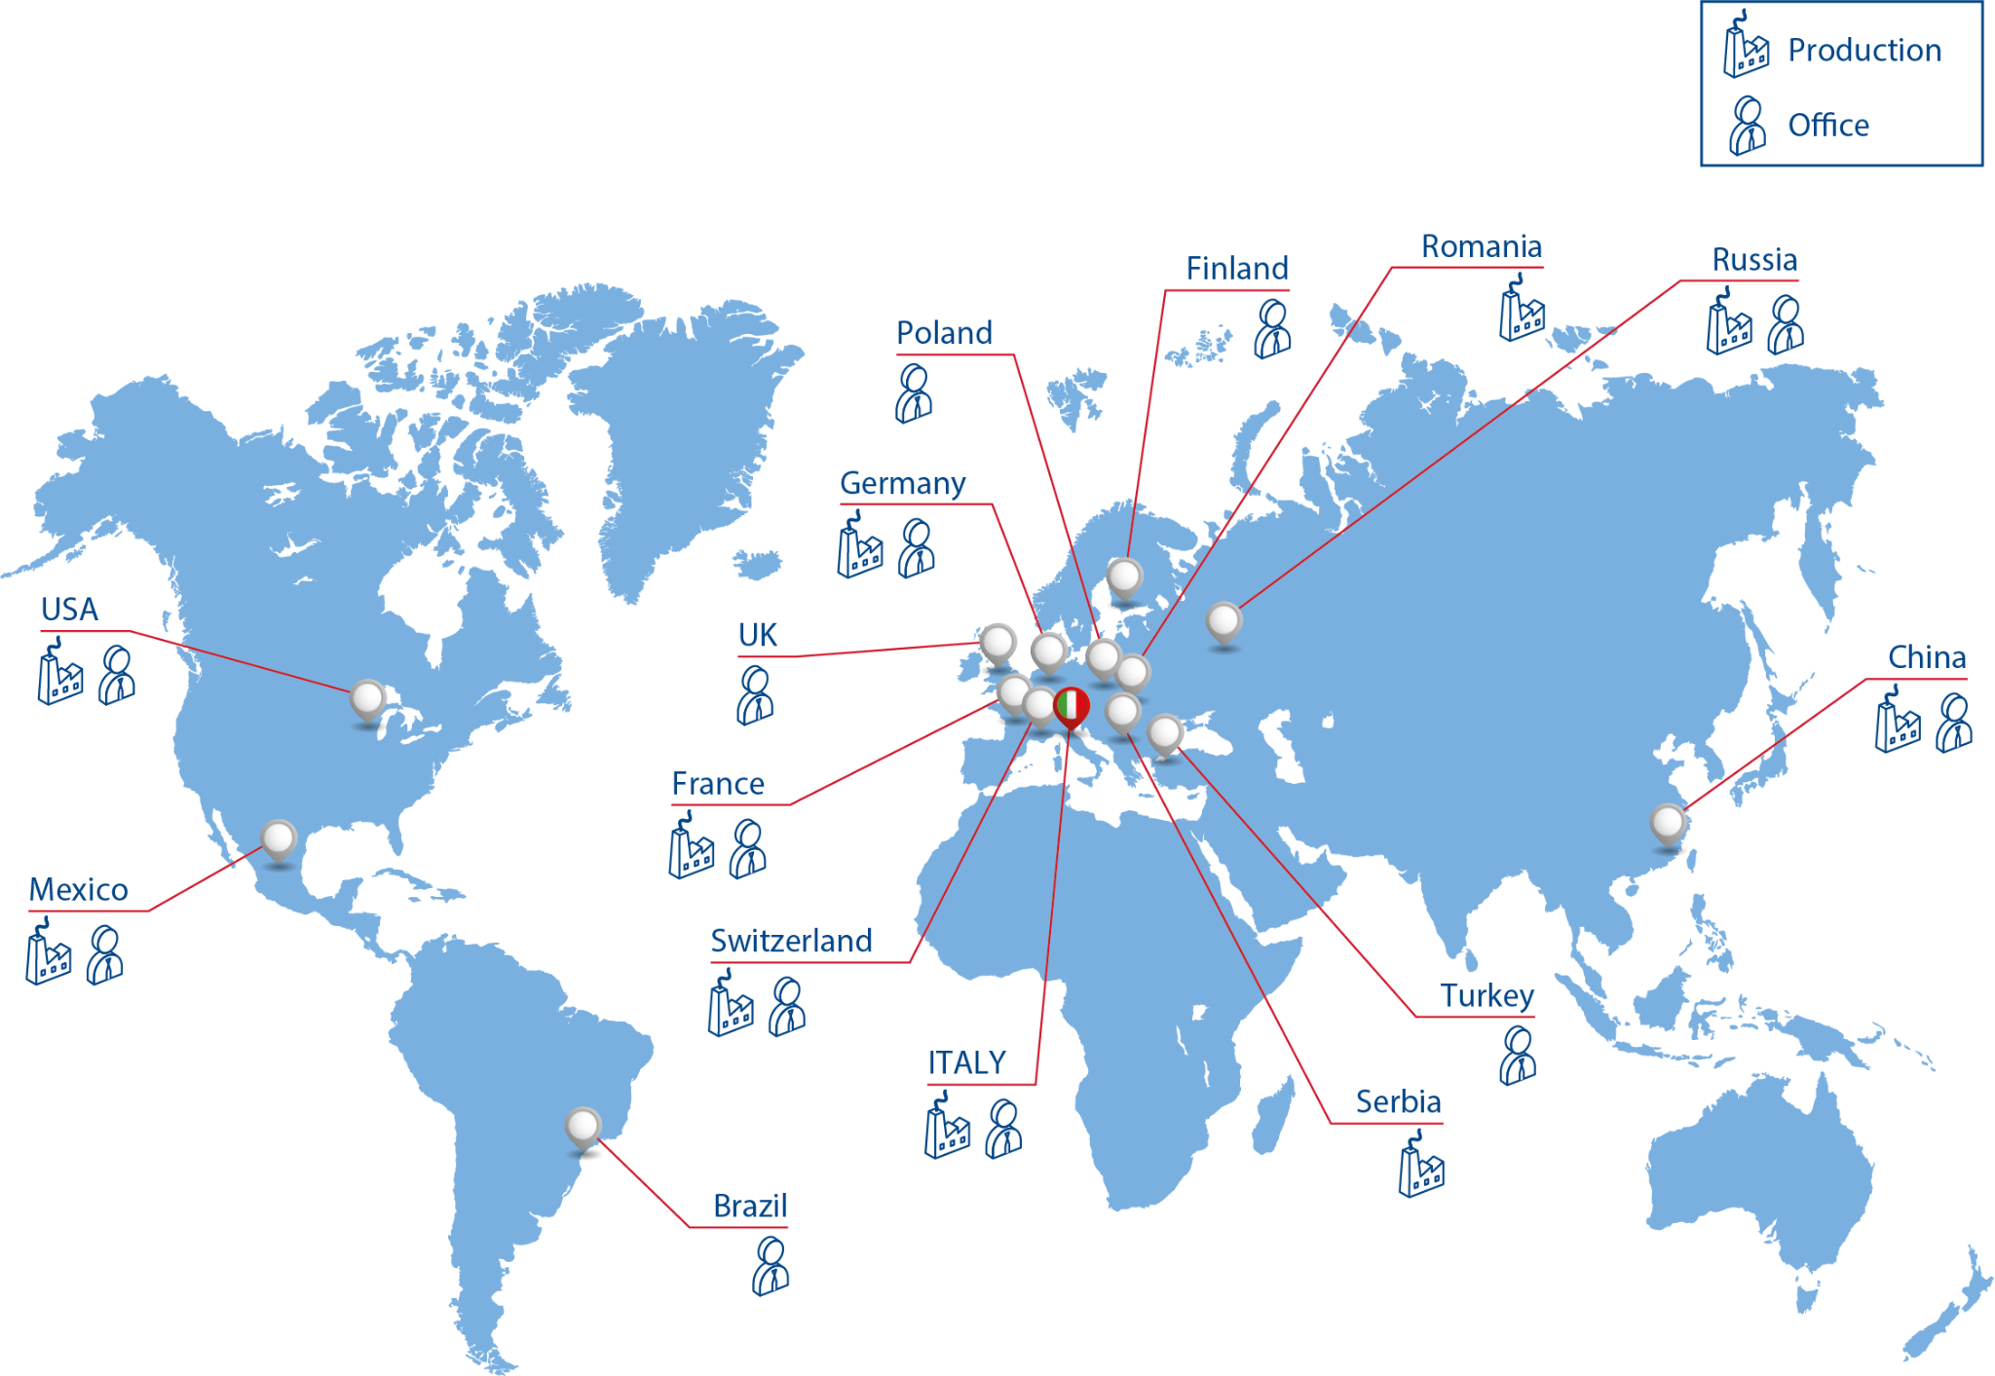
ZOPPAS INDUSTRIES HEATING ELEMENT TECHNOLOGIES
60
years of experience in design and production of heating systems
15
Countries with offices
>8000
11
employees
Countries with production sites
200
We provide heating solutions for more than 200 different application sectors.

Slide 3
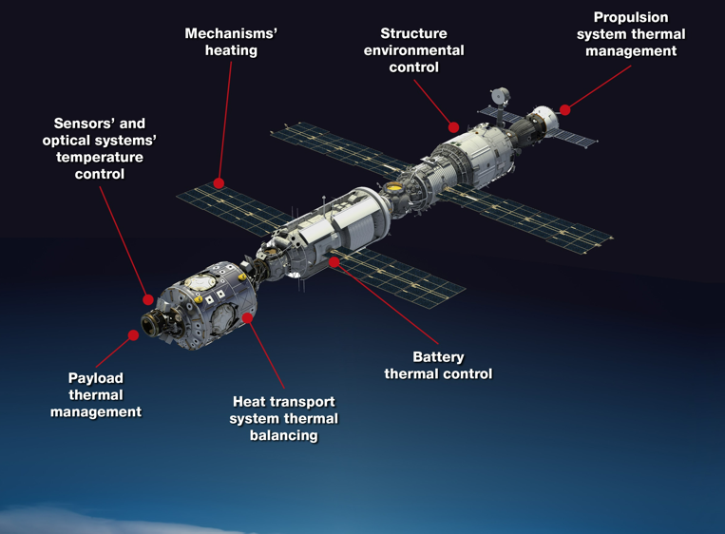
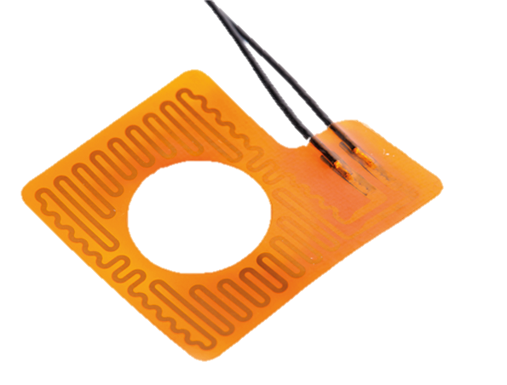
FLEXIBLE HEATERS: DEFINITION
Flexible Heaters are crucial components for the Thermal control, thanks to their versatility and efficiency in the uniform distribution of heat at different power densities.
They are widely used in various parts of satellites or habitable modules, including propulsion elements, electronics, batteries, structures, optics, detectors and more.
Below are some of the key technological challenges associated with this type of product, and how Zoppas Industries Heating Element Technologies (ZIHET) is addressing them.

Slide 4
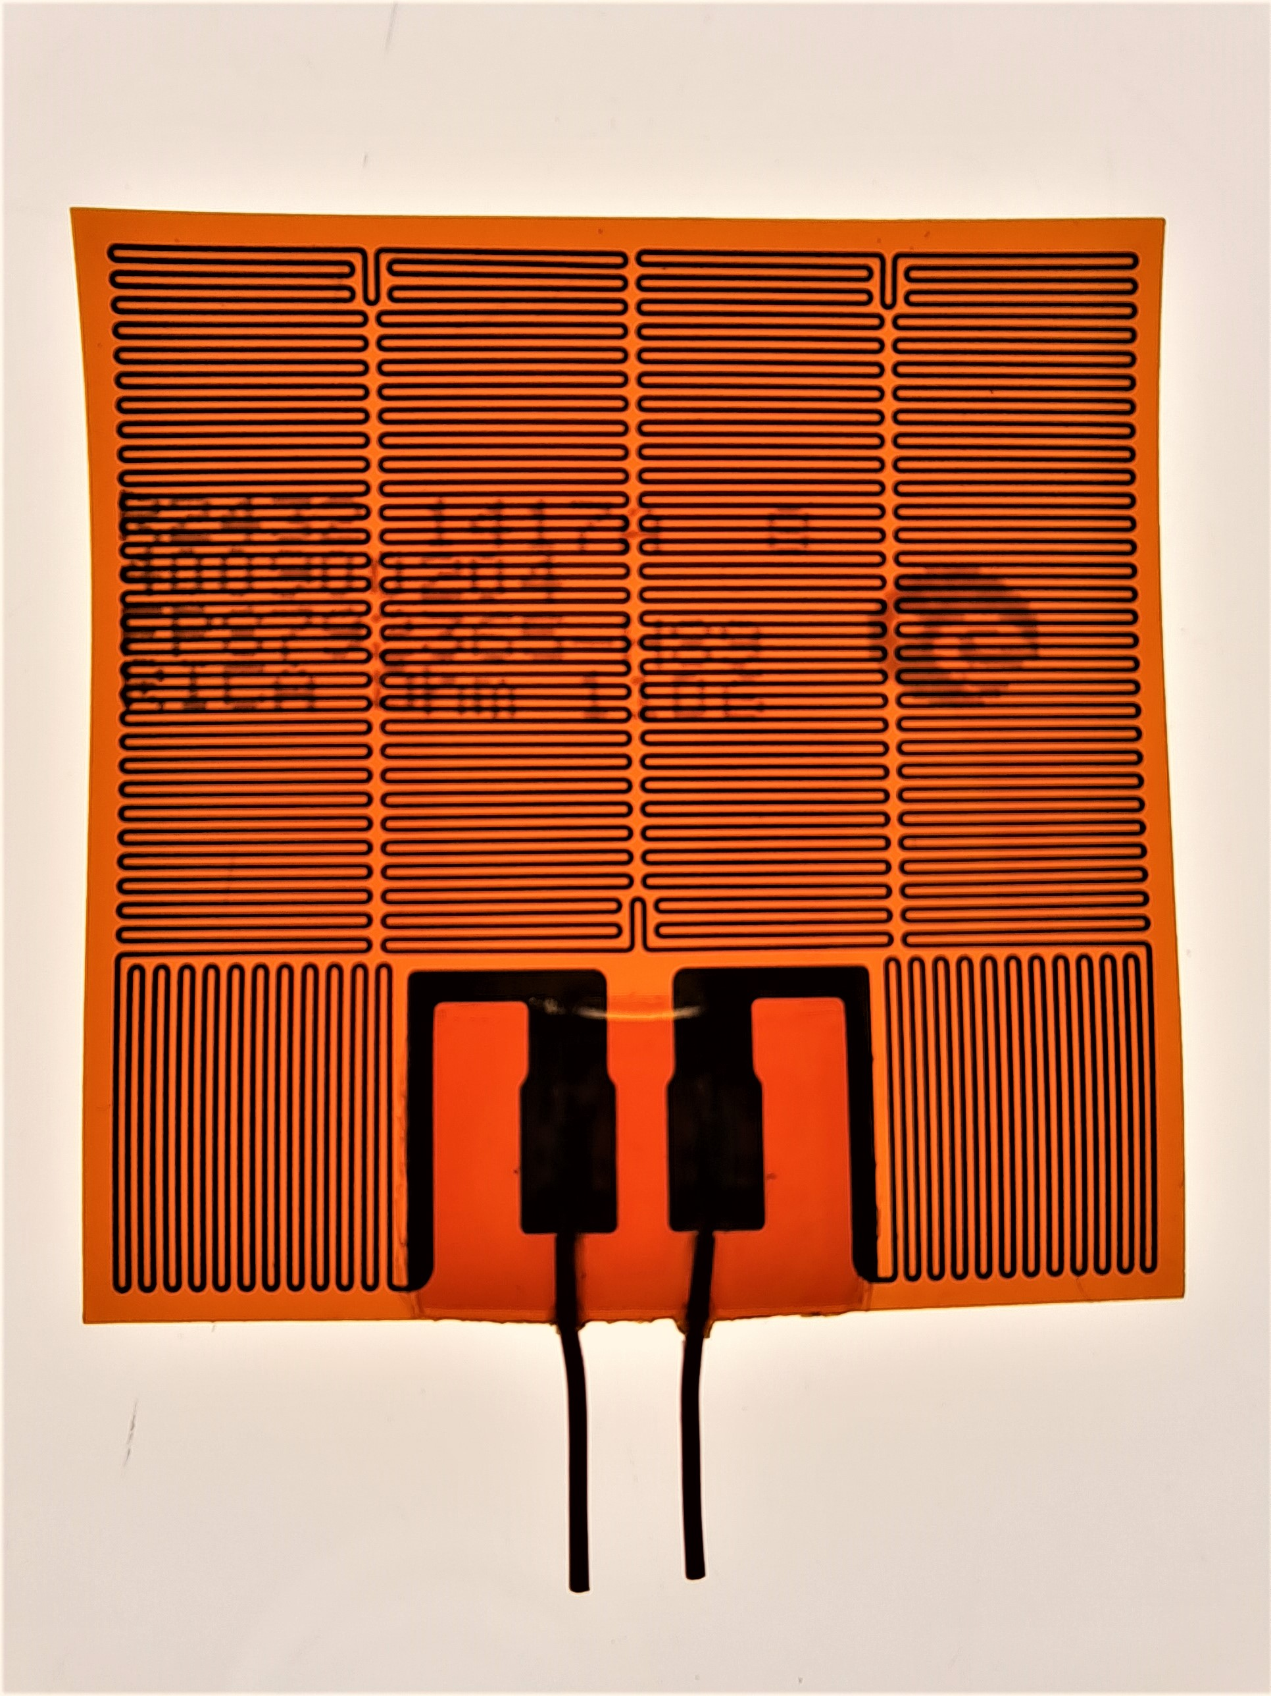
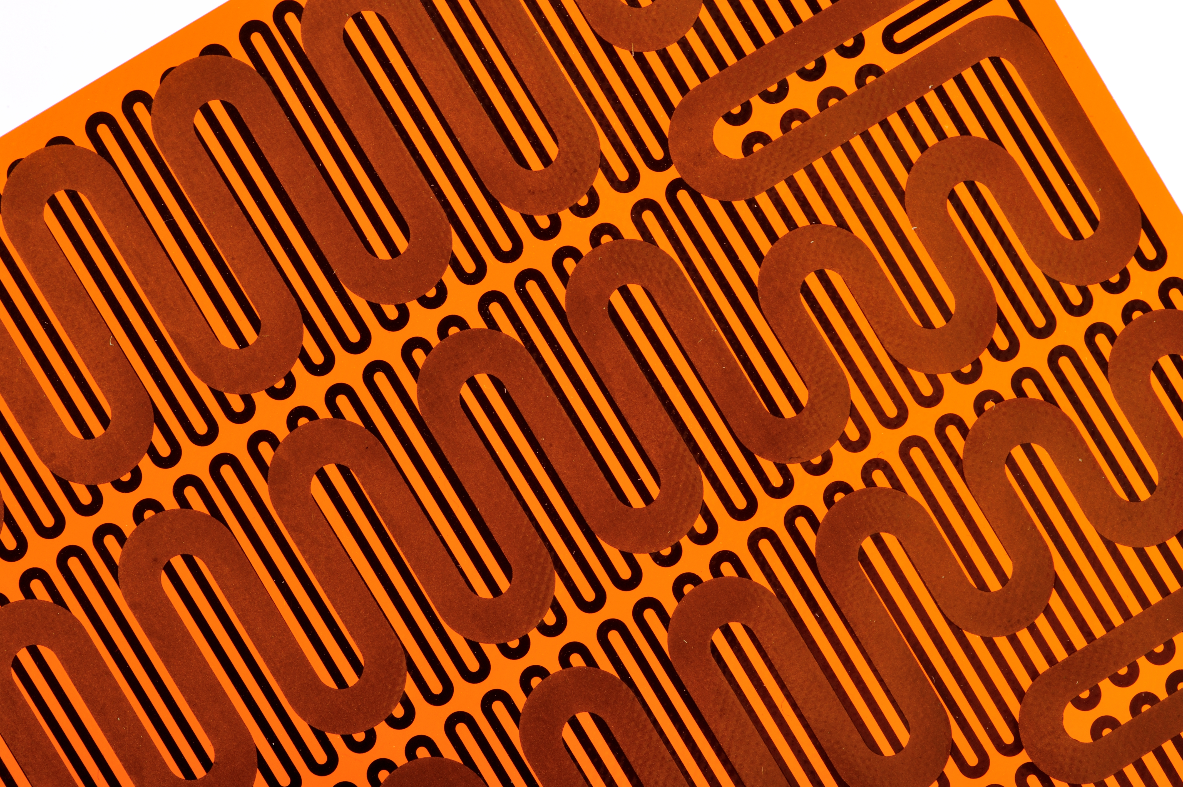
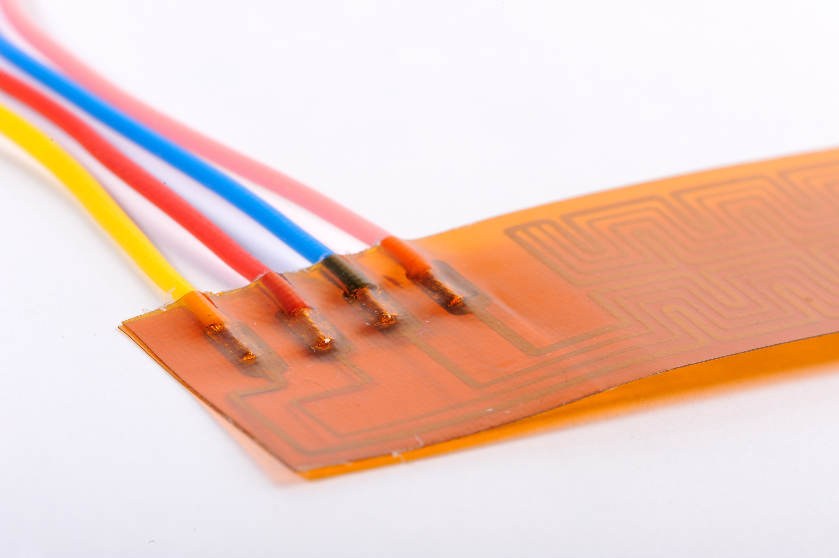
RELIABILITY
Heaters must be extremely reliable and able to operate without failure for long periods of time.
ZIHET is a global supplier of heaters, currently the only qualified one ESCC (ESCC 4009/002 - ESCC 4009/004) since 1992. This certification, which is renewed every 2 years by ESA, guarantees full compatibility for the flight of theheaters, demonstrated by the long heritage in the main ESA, JAXA and ISRO space missions.
Furthermore, ZIHET offers several options in terms of redundancy, to cover all possible thermal control system design choices: single or double circuit, single or double layer heaters.

Slide 5
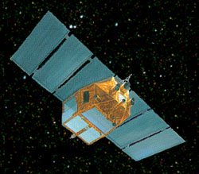
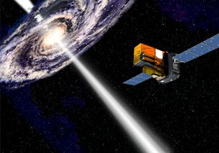
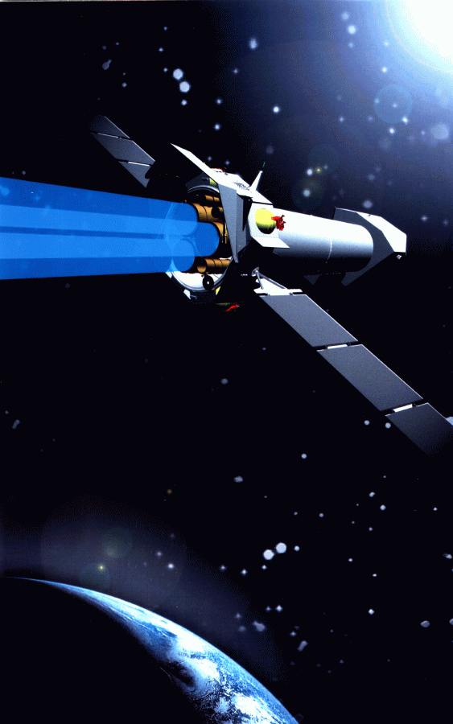
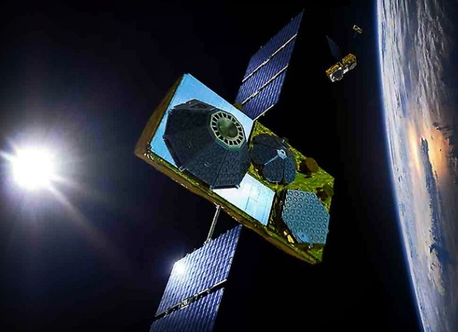
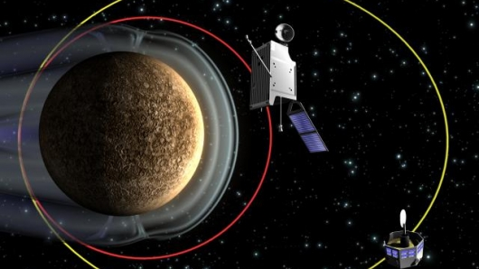
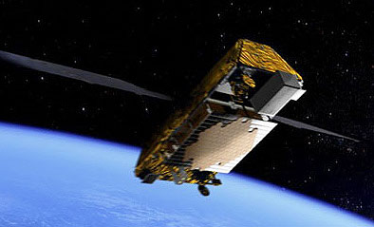
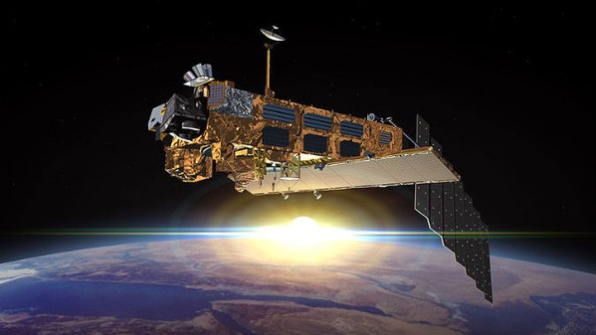
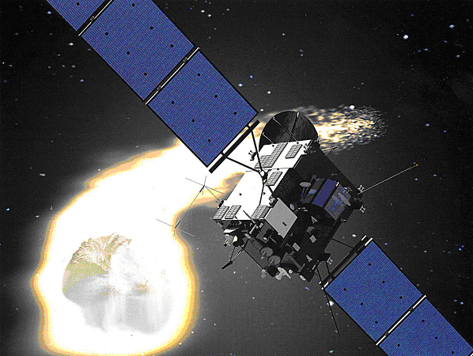
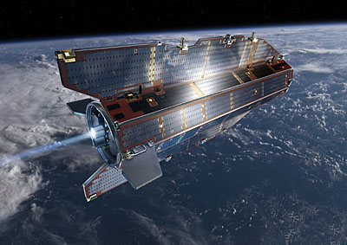
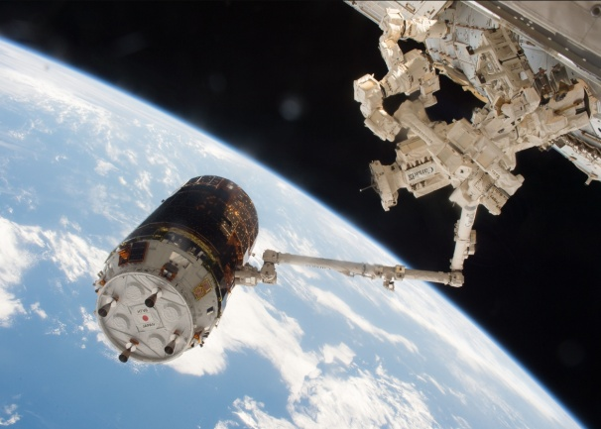
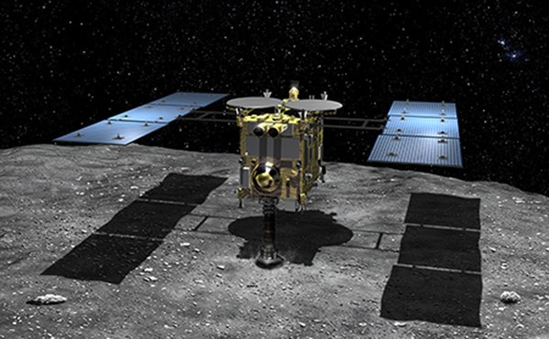
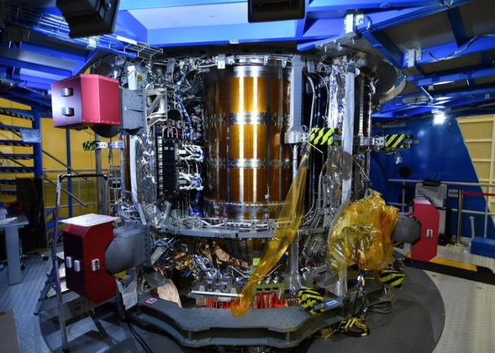
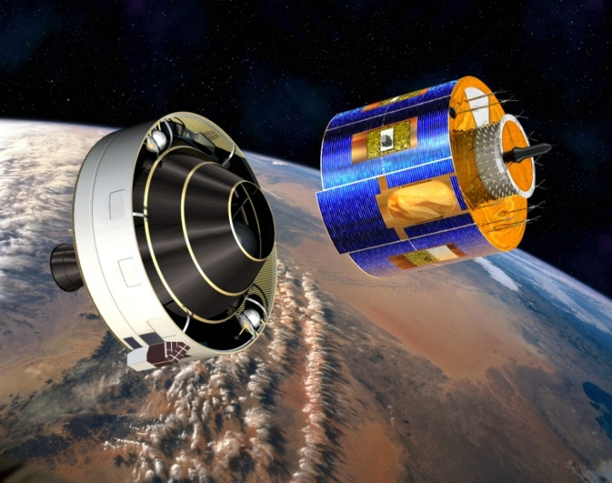
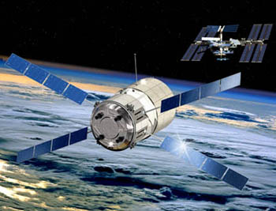
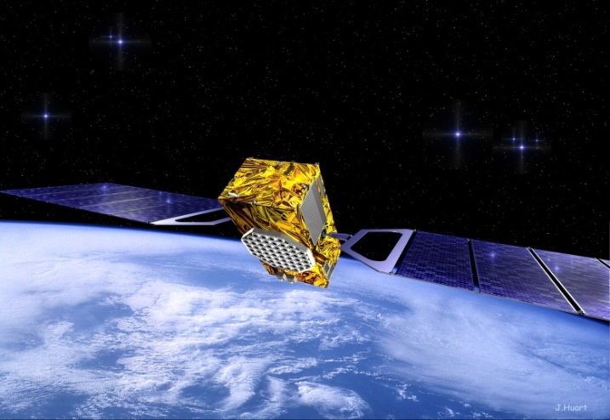
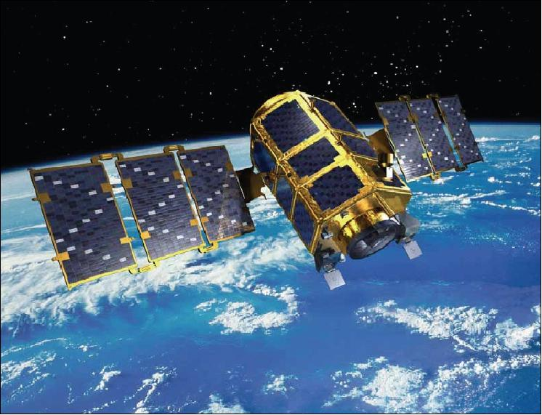
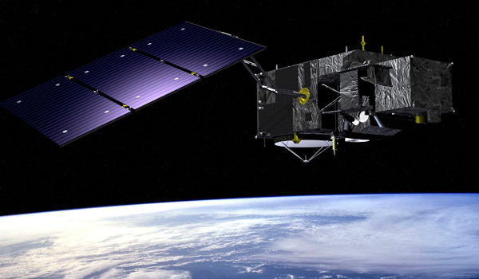
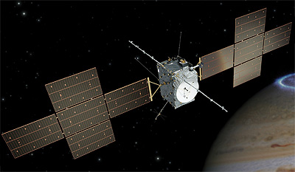
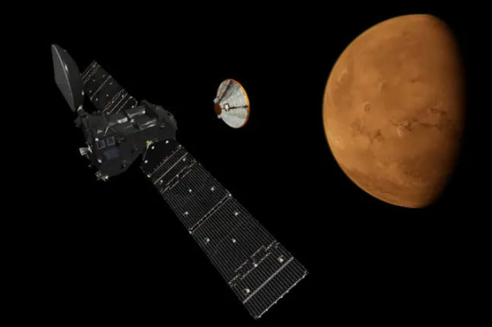
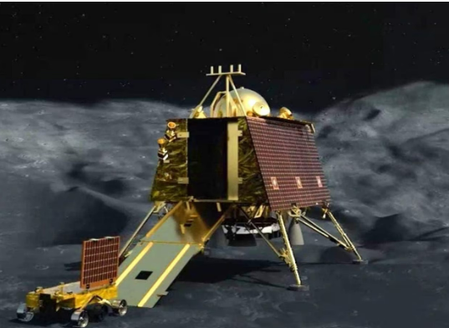
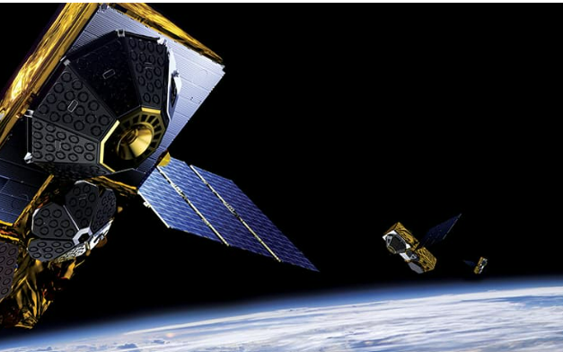
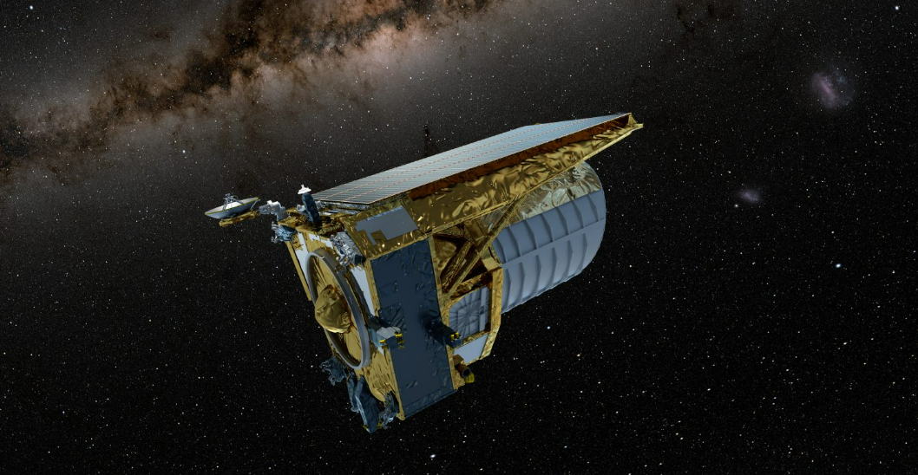
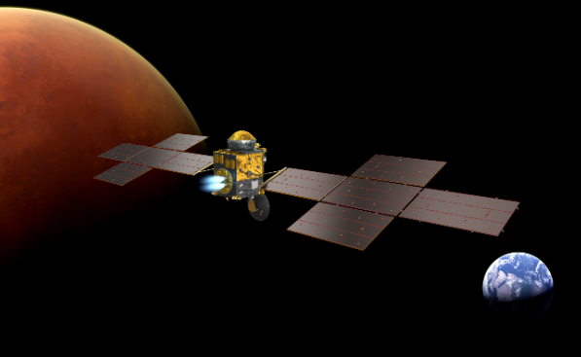
Some examples of our heritage
SAX
INTEGRAL
XMM-Newton
O3B
BEPI COLOMBO
IRIDIUM NEXT
ENVISAT
ROSETTA
GOCE
HTV
HAYABUSA 2
MPCV - ORION
METEOSAT
ATV
GALILEO
KOMPSAT
SENTINEL
JUICE
EXOMARS
CHANDRAYAN-3
Commercial constellations
GLOBALSTAR
EUCLID
MSR ERO

Slide 6
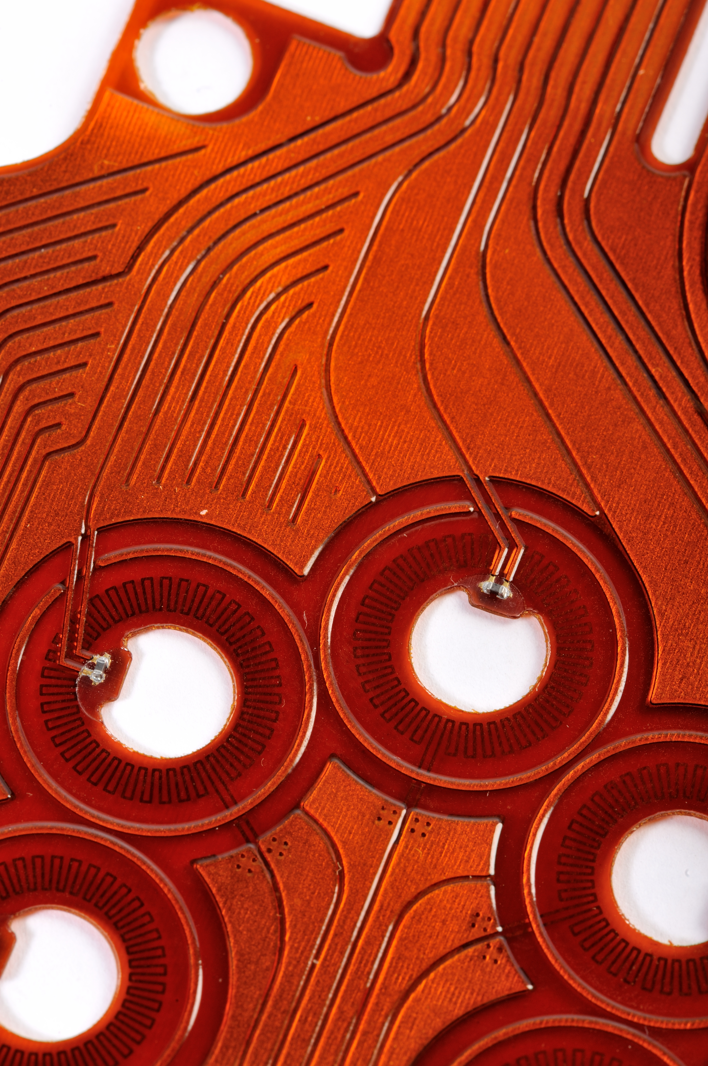
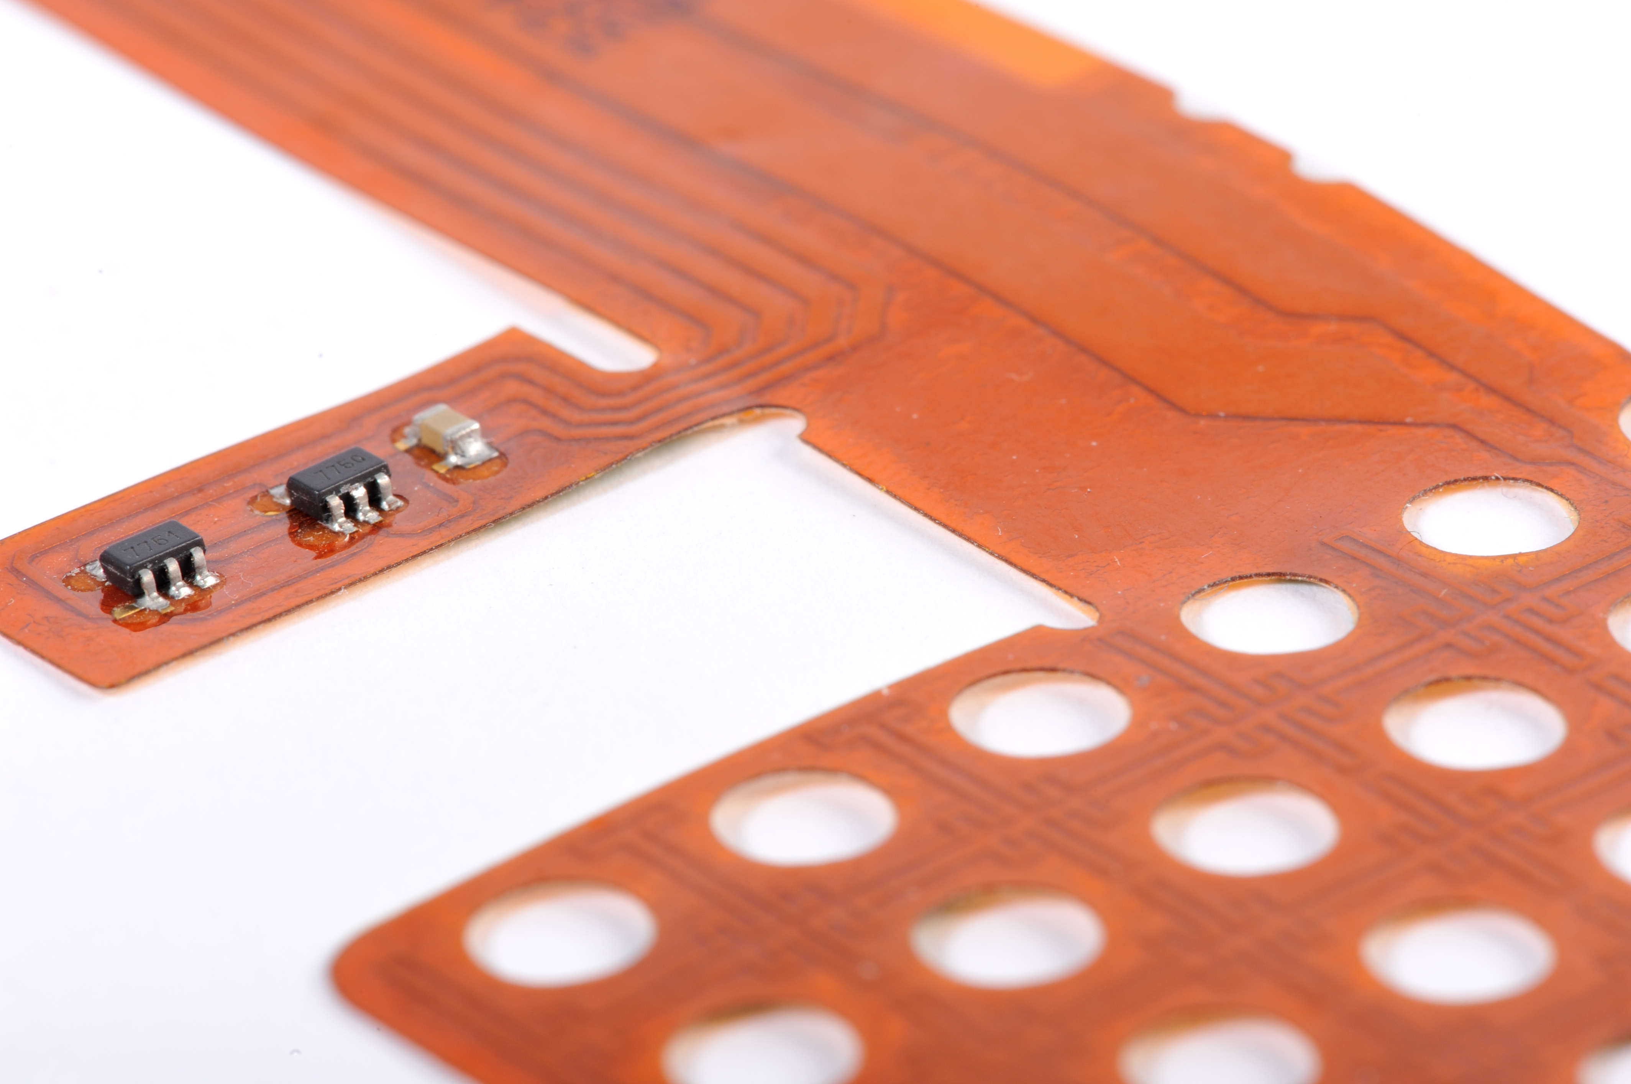
RELIABILITY
To increase the reliability of heaters, furthermore, a commonly requested strategy is the application of safety rules (derating). In particular, the one applicable to heaters according to the ECSS-Q-ST-30-11C standard provides (for rev.2) to power the heaters ensuring a margin of 50° on the maximum qualification temperature.
The Customer therefore needs to know this temperature at least during the testing and correlation phase. ZIHET can support this process by providing flexible heaters equipped with an integrated temperature sensor (PT100/PT1000/NTC)- solution commonly supplied by ZIHET for other markets, e.g.,medical.

Slide 7
INTEGRATIONWITH OTHER COMPONENTS
ZIHET recently qualified with IPC 610/620 and ECSS-Q-ST-70-26C certifications to supply assembled heaters with connectors, to:
Facilitate the integration of the electrical interface with the power subsystem
Simplify the Supply Chain
Reduce supply times thanks to standardization of connections
When the thermal environment to be regulated is distributed in small dimensions, and the TRP is located close to the heater, a product that integrates a heating element and an ESCC-qualified temperature sensor (PT100/PT1000/NTC) can help optimize the integration.
Ongoing:
ESCC Qualification of the assembly «connectorized heater»
Ongoing:
→ ESCC qualification of the assembly «flex heater with embedded temperatures sensor»

Slide 8
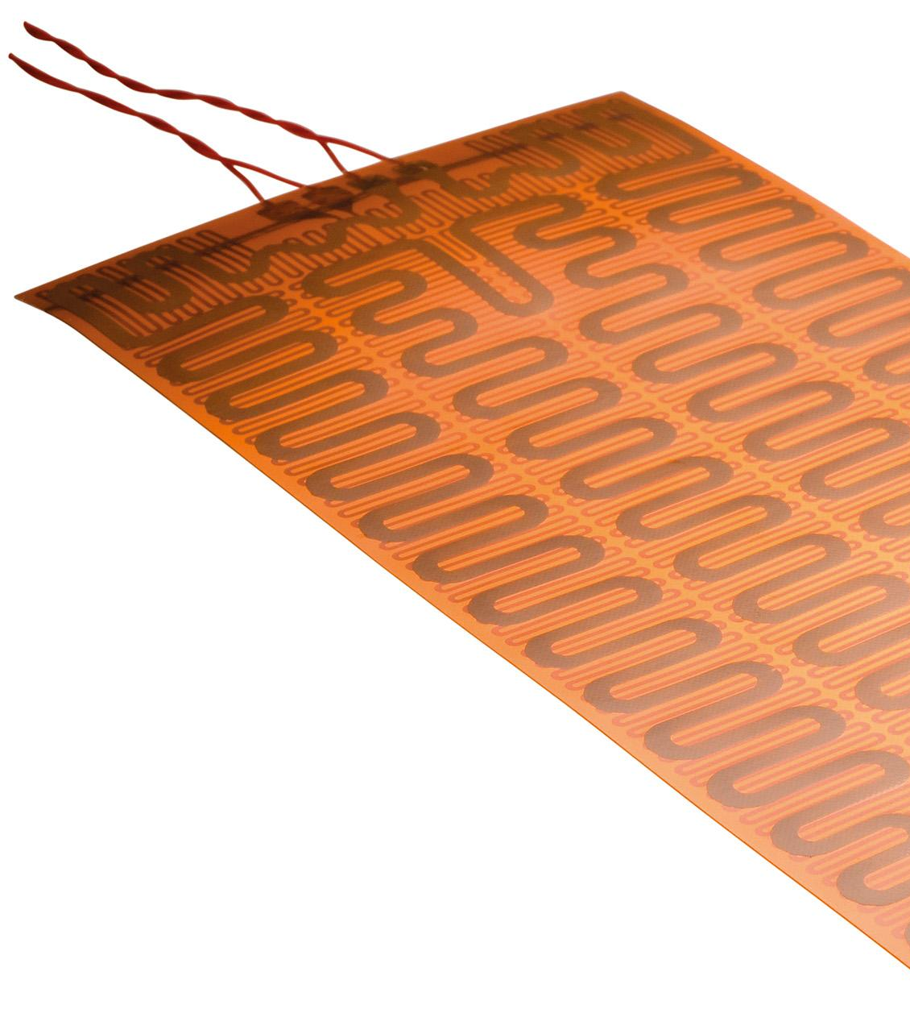
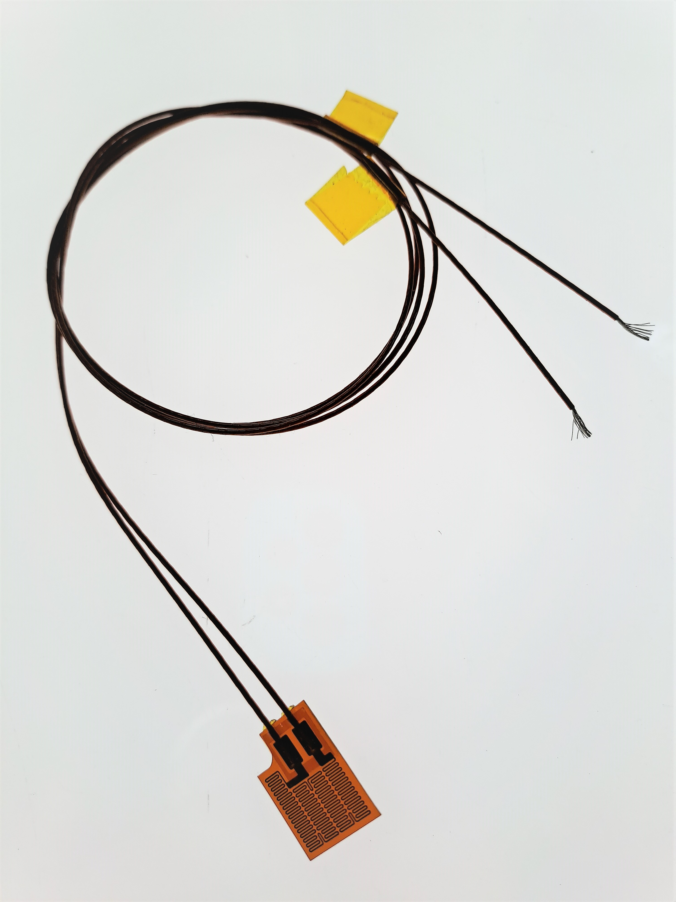
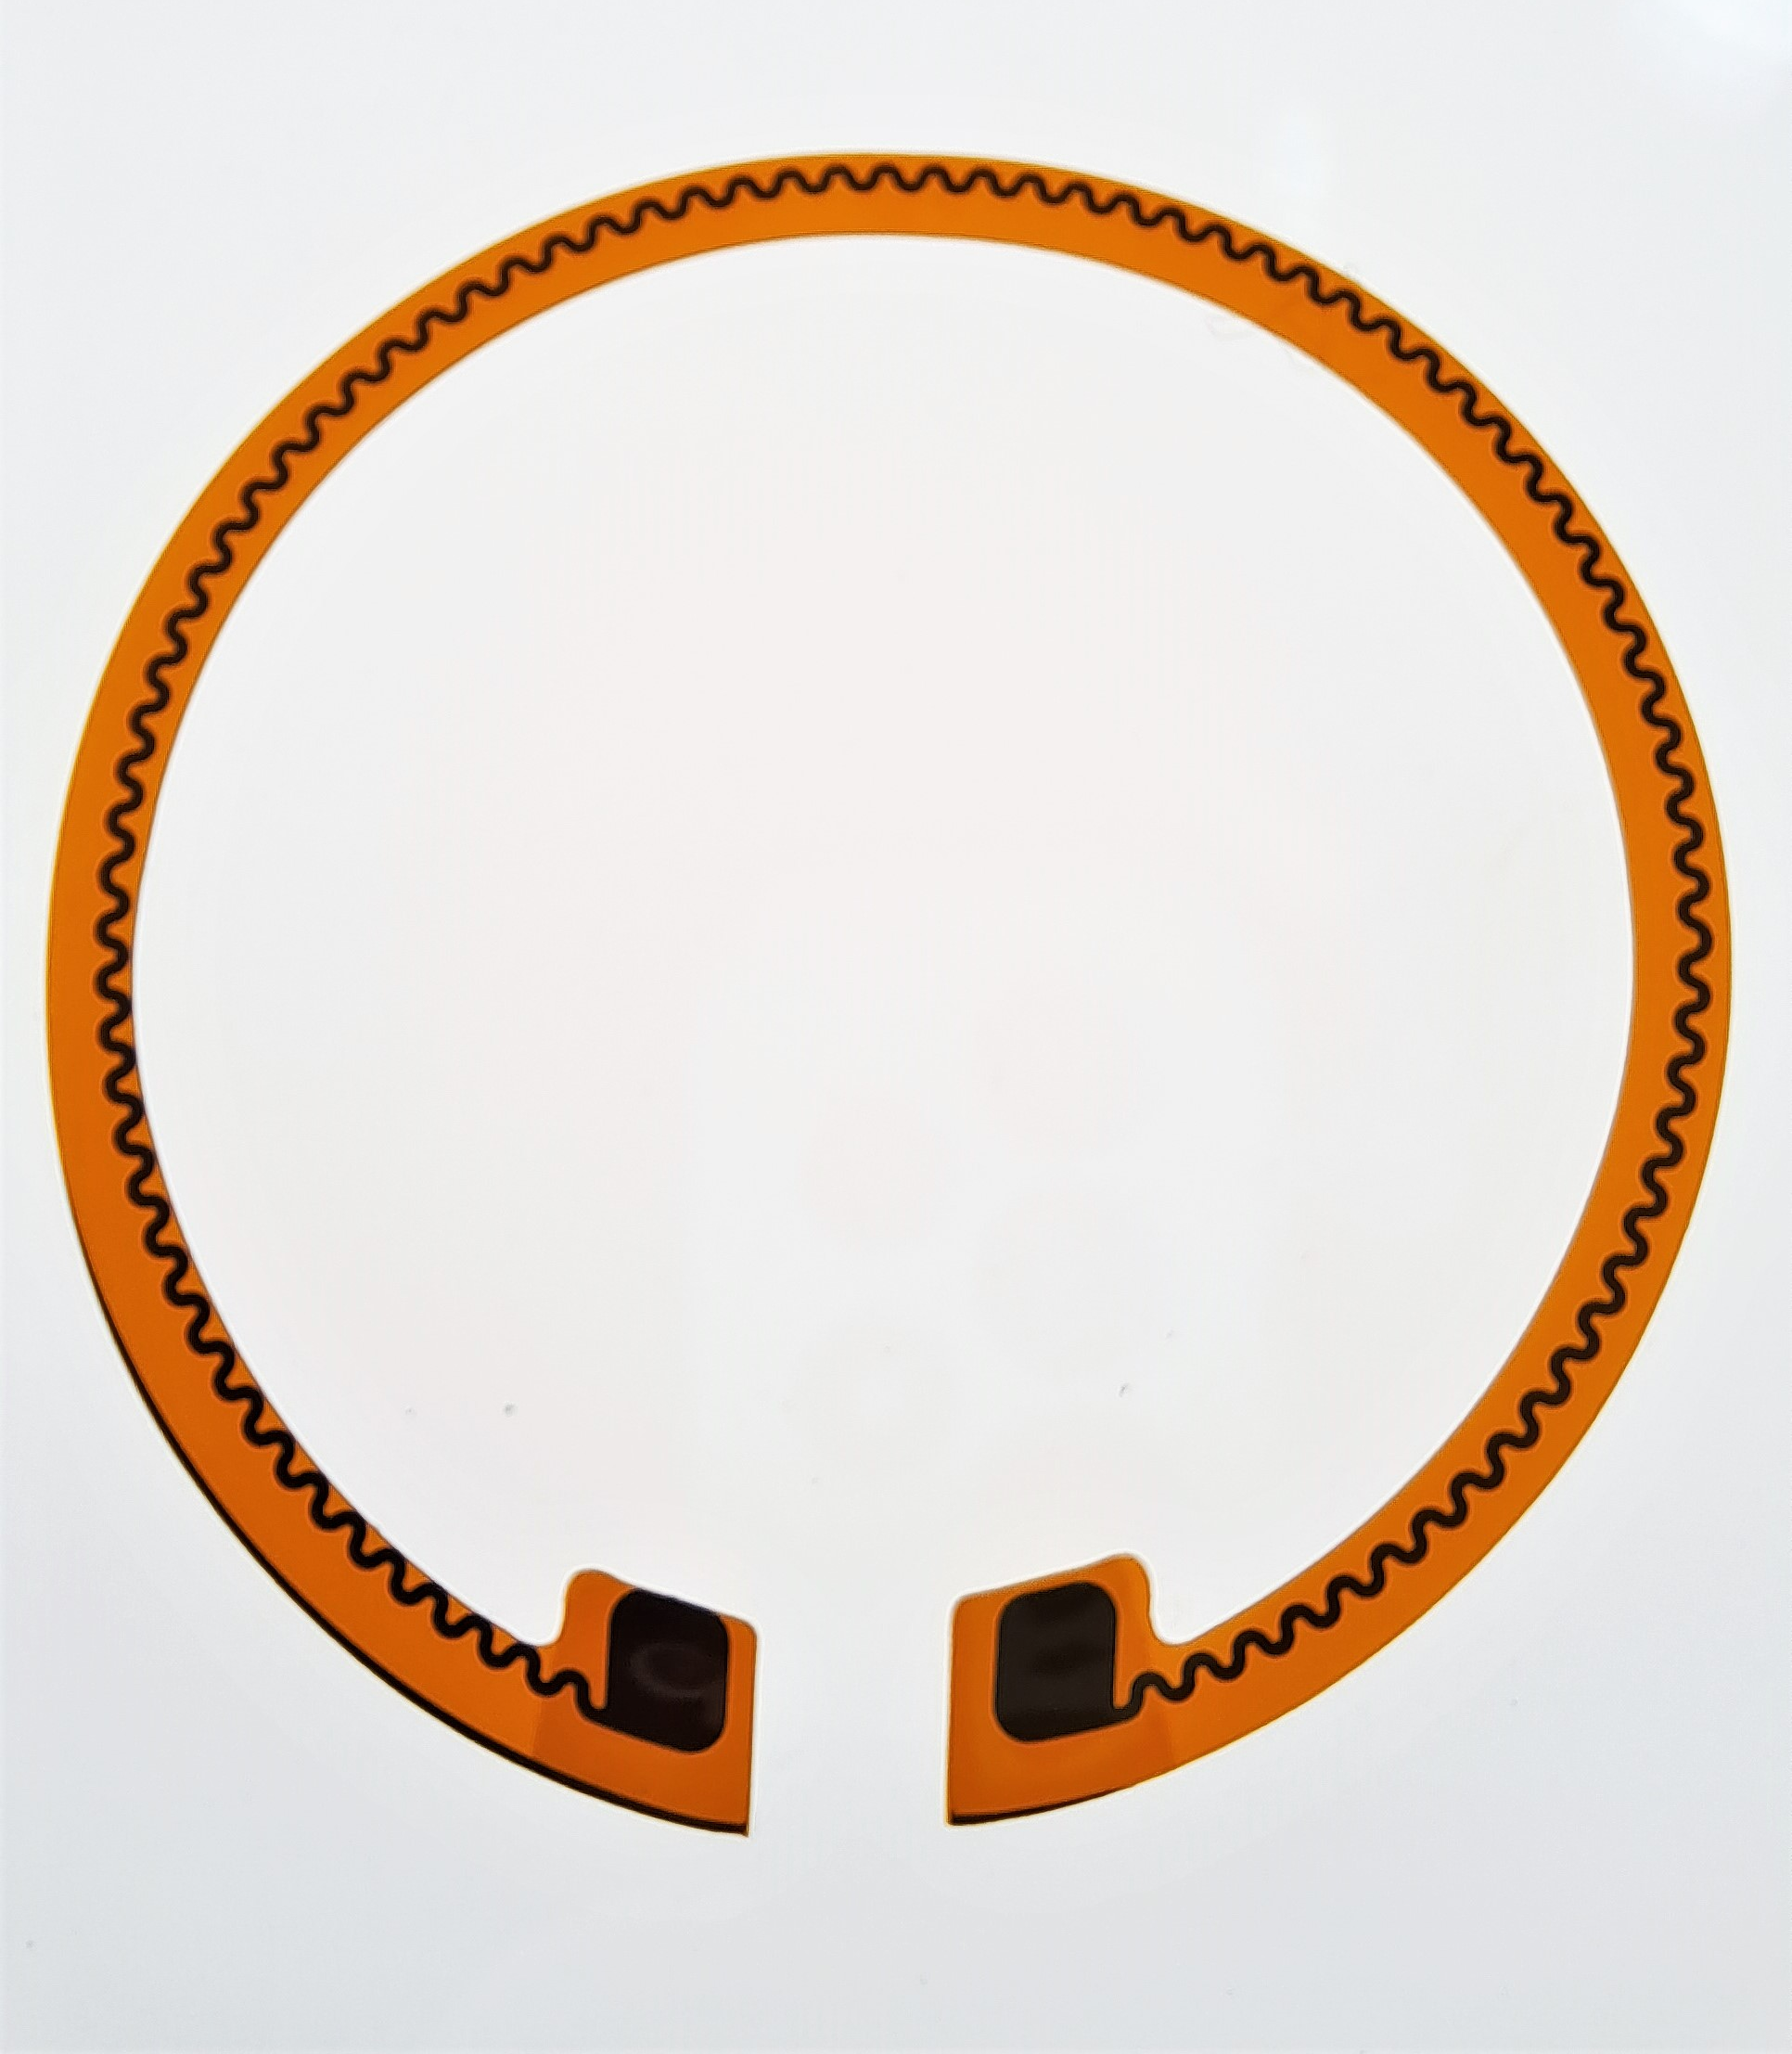
REDUCTION IN SIZE AND WEIGHT & INTEGRATION
In the context of space missions, optimizing size and weight of components is crucial. Flexible heating technologies are designed to be lightweight and compact, allowing for efficient use of space within platforms. ZIHET flexible heaters start at a minimum thickness less than 0.2 mm and can reach a Ohmic density up to 330Ω/cm^2.
Flexible heaters must be designed for easy integration with other components and systems present on board.
Their shape can be totally customized, recreating the most complicated geometries
Thanks to their thickness and their flexibility (with a bending radius of 1 mm), they can be applied to the most complex shapes and curves without sacrificing efficiency or reliability.

Slide 9
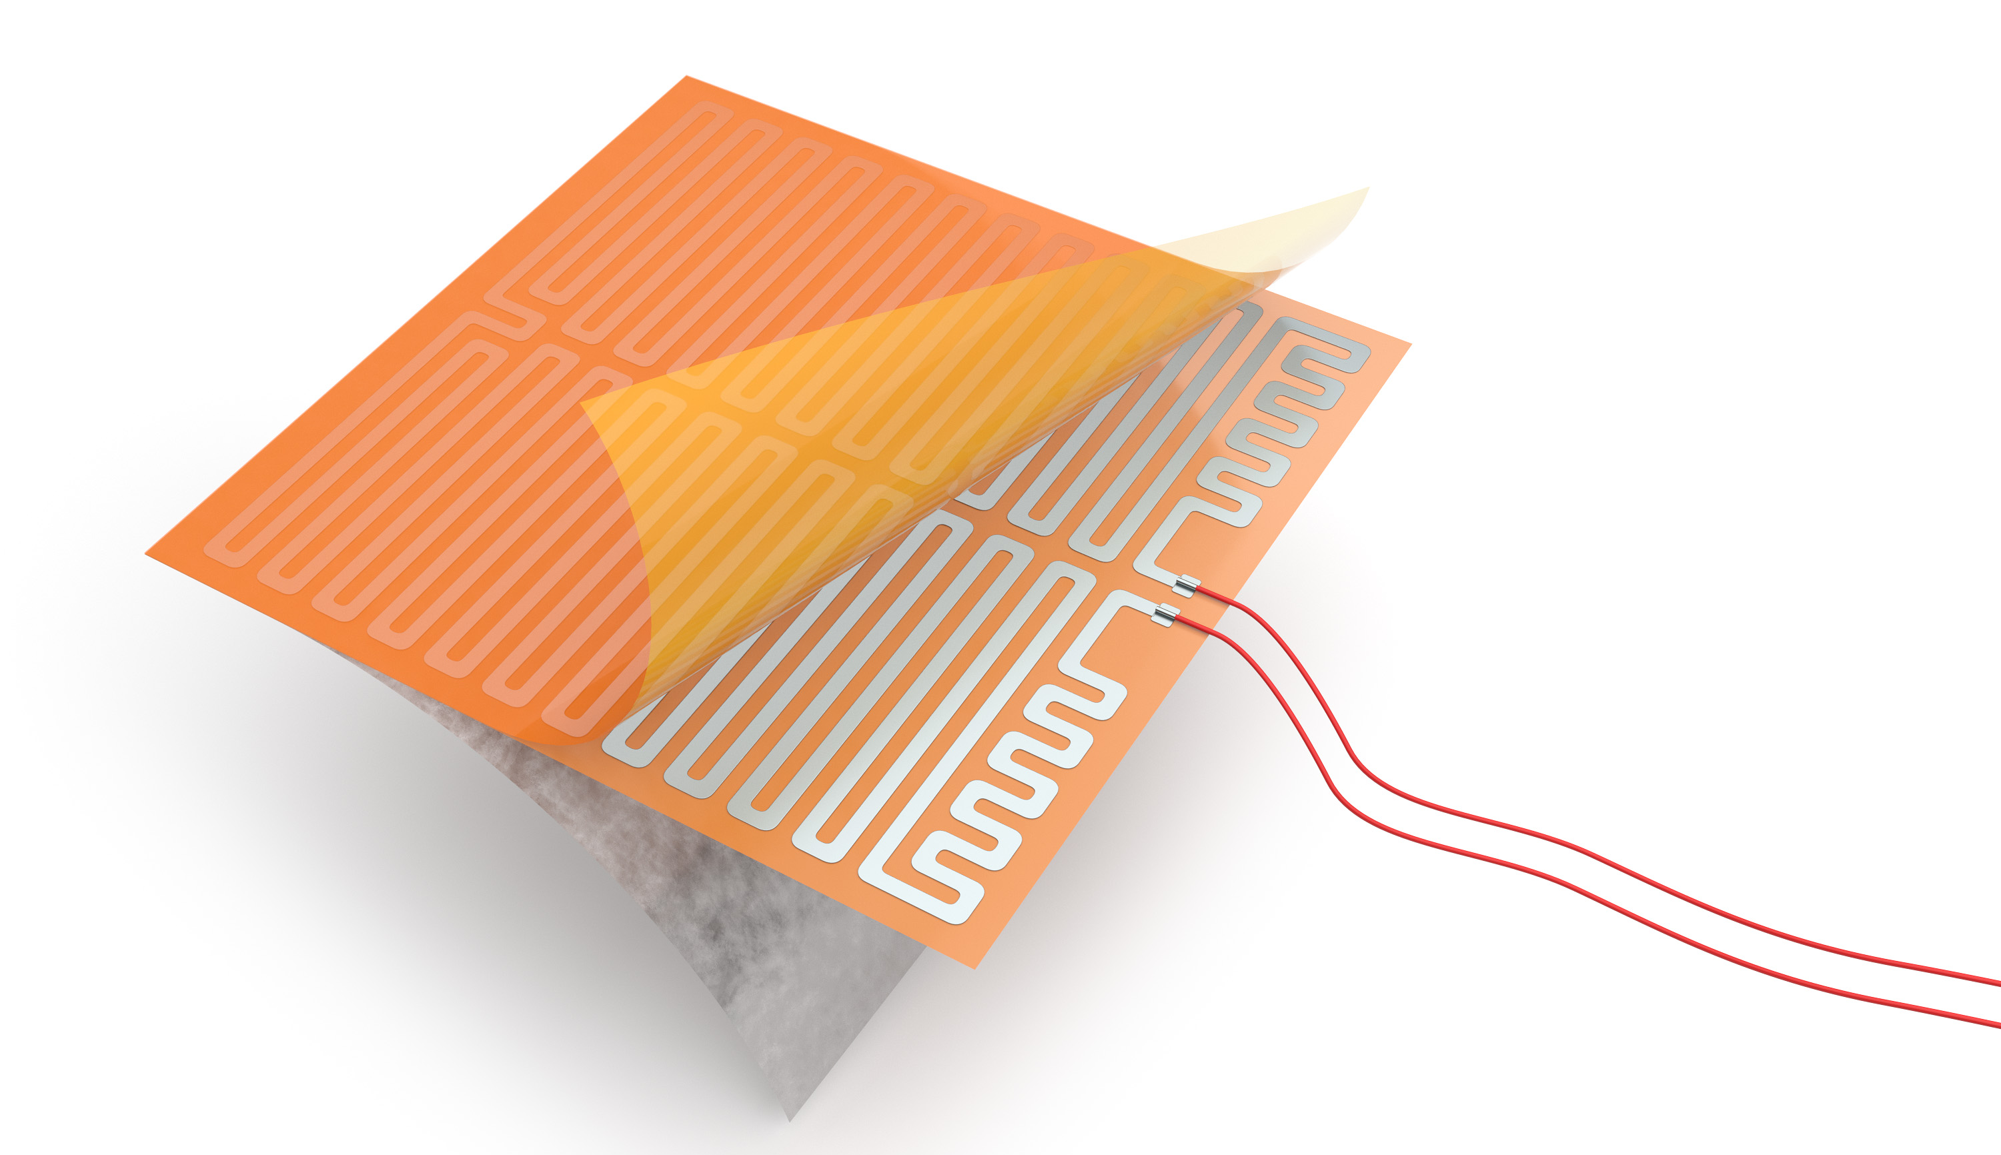
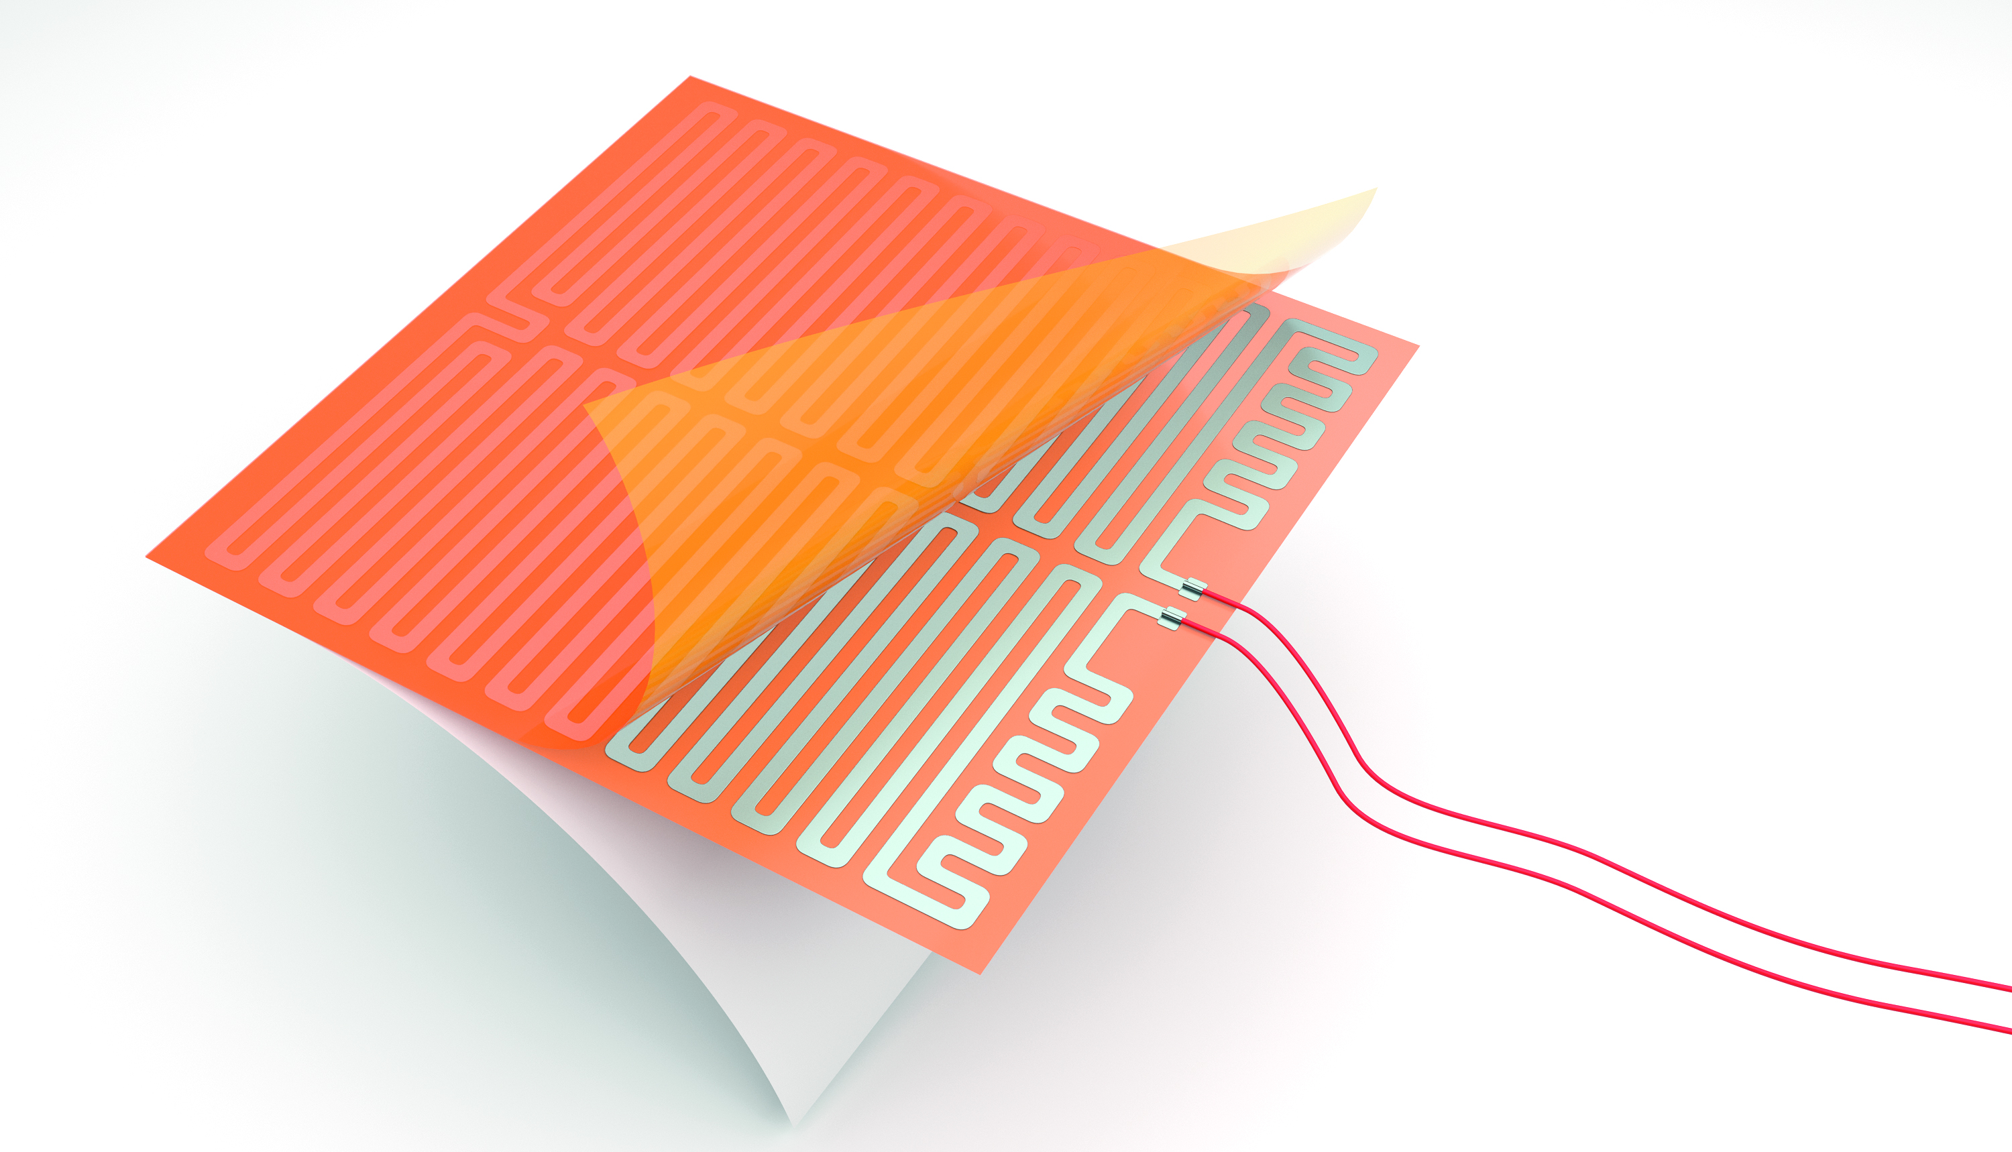
HEAT EXCHANGE EFFICIENCY
ZIHET flexible heaters allow excellent heat transfer results thanks to their slim design and direct bonding to the heat sink.
They are supplied with one optional layer of qualified adhesive (PSA 3M 966), and they are ready to be glued onto the satellite components.
Additionally, each heater can be supplied with an additional aluminum substrate which improves thermal efficiency. The aluminum layer acts as a heat diffuser, helping to dissipate heat more effectively across the heated surface.

Slide 10
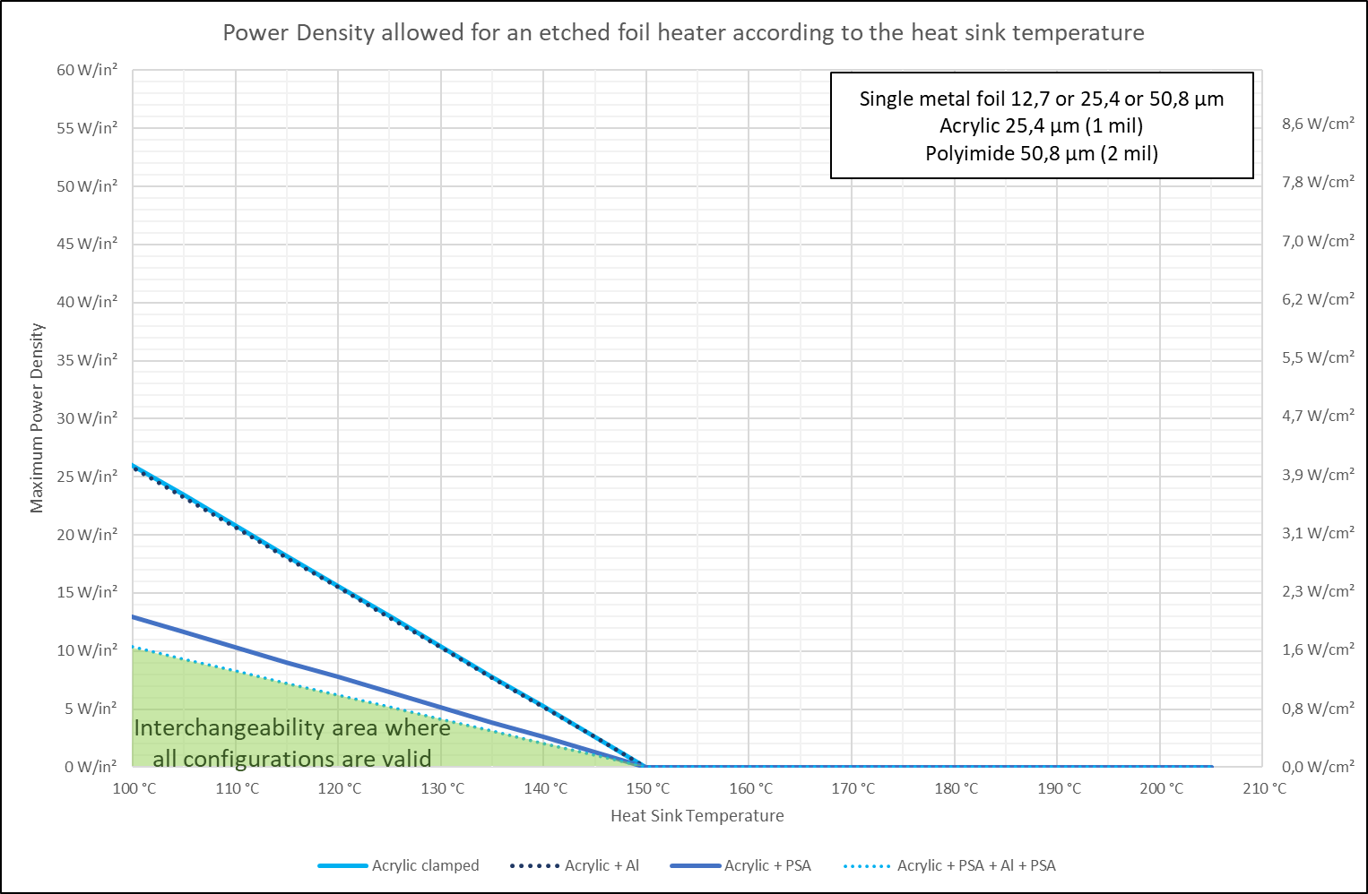
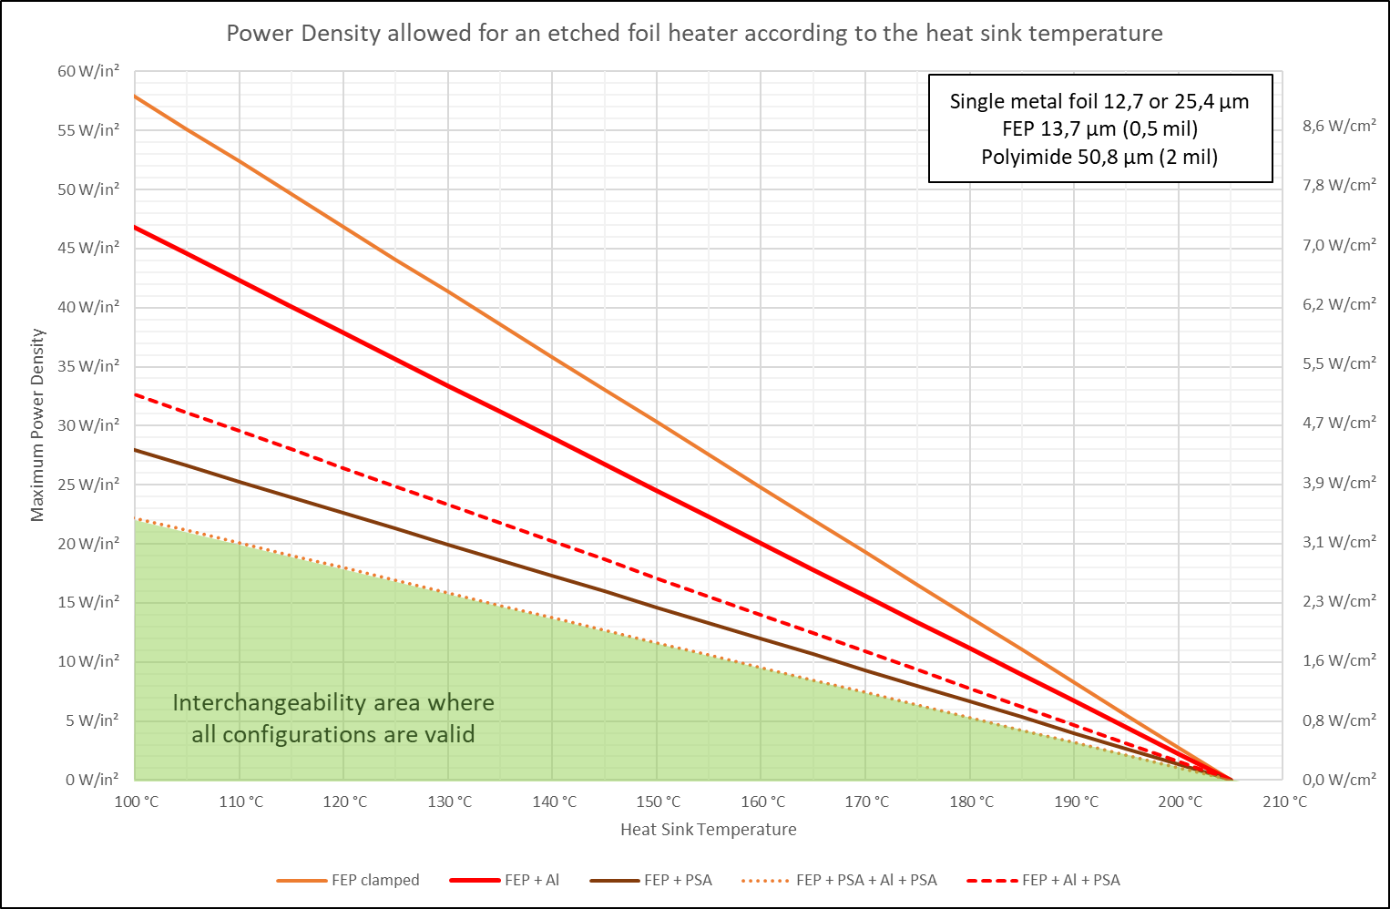
DESIGN OPTIMIZATION
An optimal design of the subsystem also depends on the choice of materials and of the fixing methodologies of the heater with the heatsink, and from the sizing of the power budget depending on the operating temperatures and on the Derating rules.
ZIHET has recently conducted an internal study and experimental validation campaign to develop a digital model of the flexible heater, which simulates these parameters.
This model is called "EFSim" and is a valuable tool for engineers who find themselves in the preliminary planning and design phase of the thermal control system.
EFsim can quickly estimate the thermal performance of the flexible heater based on the specifications of the heater and the system, and to the desired operating parameters.
EFsim automatically draws a graph showing the maximum power density of this configuration based on the temperature of the heatsink.
The user can easily compare the usage range of different materials with a simple visual aid.

Slide 11
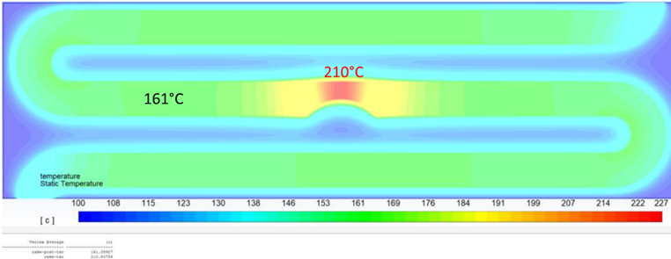
DESIGN OPTIMIZATION: SIMULATIONS
The model has been validated with a 3D numerical simulation using ANSYS Fluent and experimental tests.
A series of 3D simulations has been made on ANSYS Fluent to estimate the impact of a Track Section Reduction on the track temperature in order to evaluate the TSR coefficient useful for the determination of the thermal resistance of the insulant layers. The same simulations confirmed that the EFSim model correctly estimates the heat transfer in a 1D system.
Notes:
Sono state fatte delle simulazioni con Ansys per misurare l’impatto di eventuali riduzioni di traccia sulla resistenza termica dei singoli strati.
Le stesse simulazioni si trovano d’accordo con i risultati di EFSim.

Slide 12
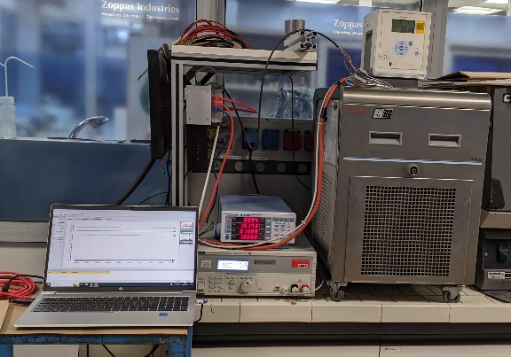
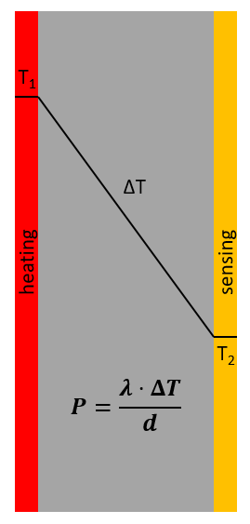
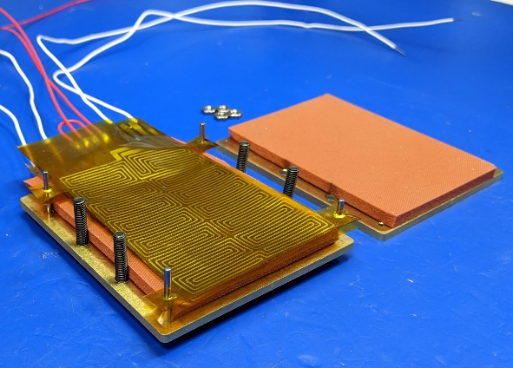
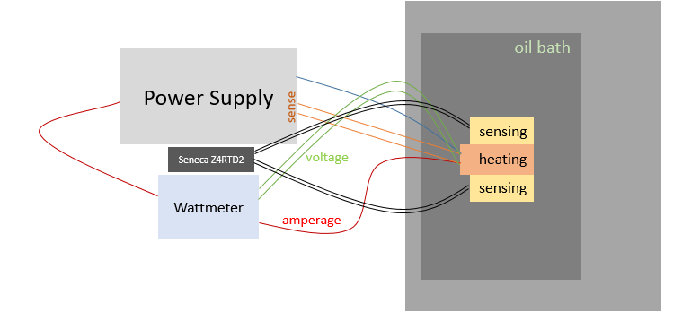
DESIGN OPTIMIZATION: EXPERIMENTAL SETUP
The model has been validated with a 3D numerical simulation using ANSYS Fluent and experimental tests.
The experimental setup used for the characterization of the thermal profile of the polymeric sheets was built to be as similar as possible to this model
Sensing element
Tested material
Heating element
Tested material
Sensing element
Notes:
Per il setup sperimentale sono stati usati un elemento riscaldante e due di sensing, tutti e tre con la traccia in nickel.
Il nickel è PTC, quindi all’aumentare della temperatura aumenta anche il valore ohmico. Calibrando gli elementi, è stato possibile
monitorare il valore ohmico per conoscere la temperatura della traccia in ogni istante. Misurando il delta di temperatura tra la traccia riscaldante e quella di sensing,
abbiamo ottenuto i thermal profiles degli isolanti (vedi slide dopo). I valori di lambda sono serviti ad avere un riscontro sulla bontà delle misure.
Il bagno ad olio serviva a mantenere delle condizioni al contorno fisse, a una temperatura di 25°C.

Slide 13
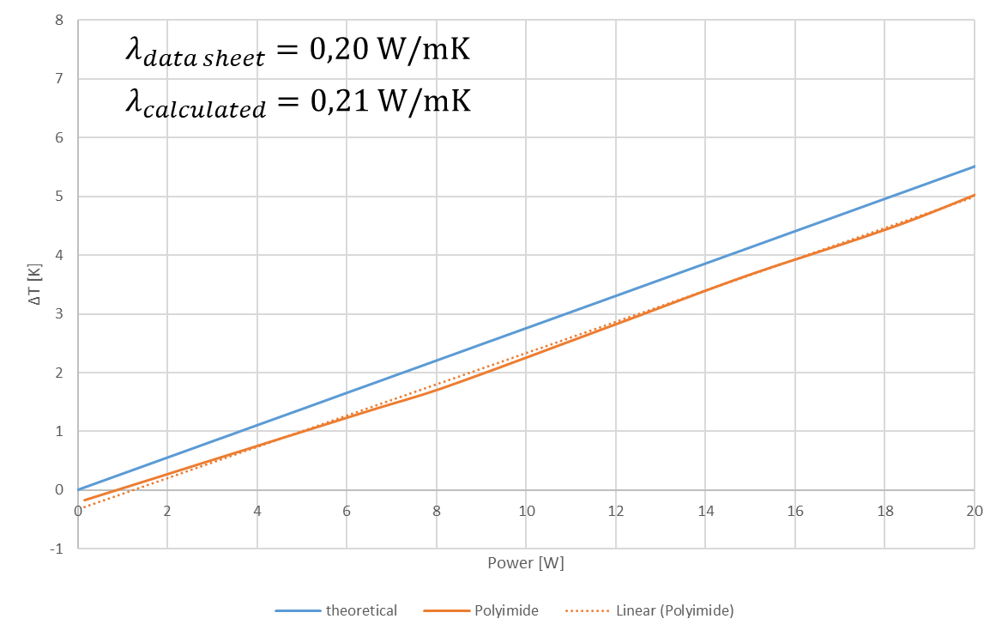
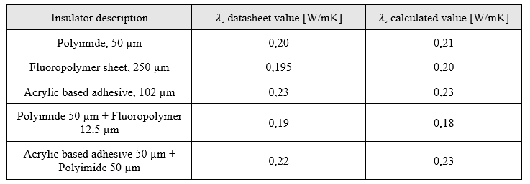
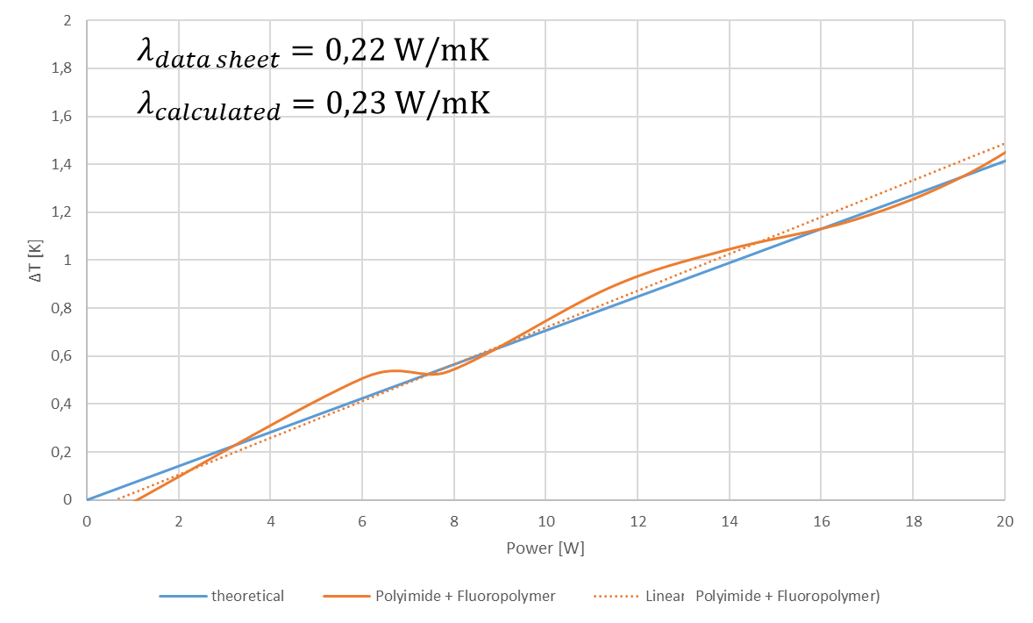
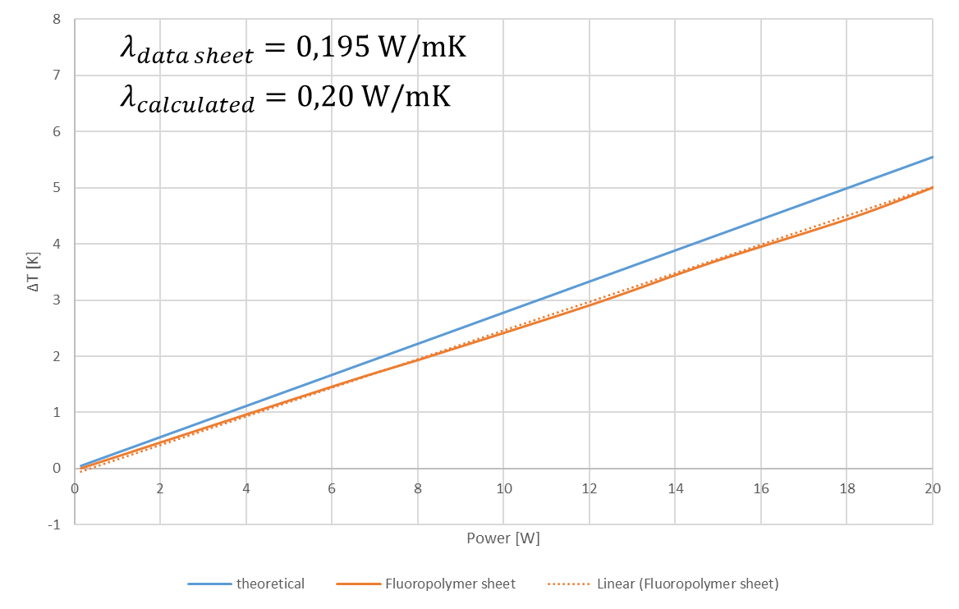
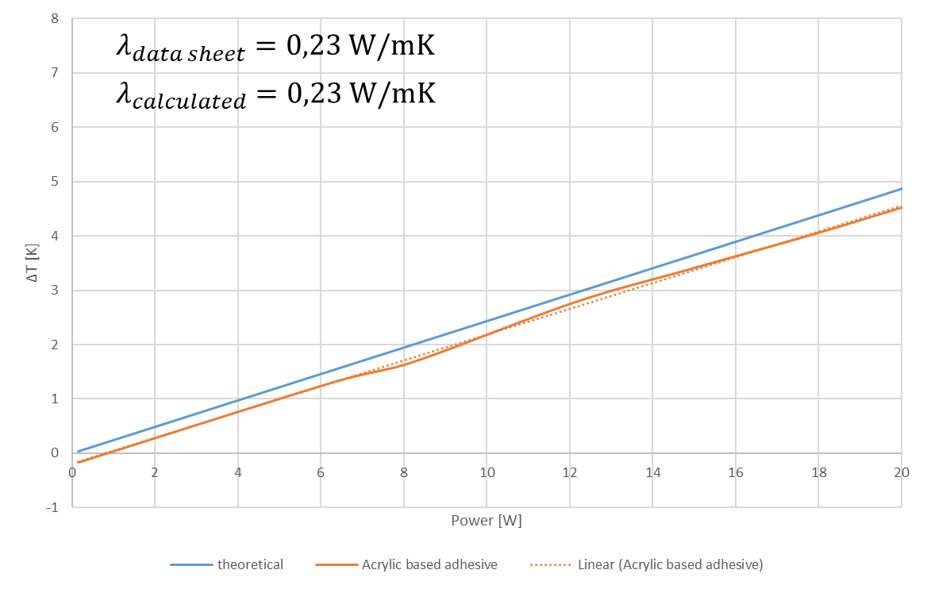
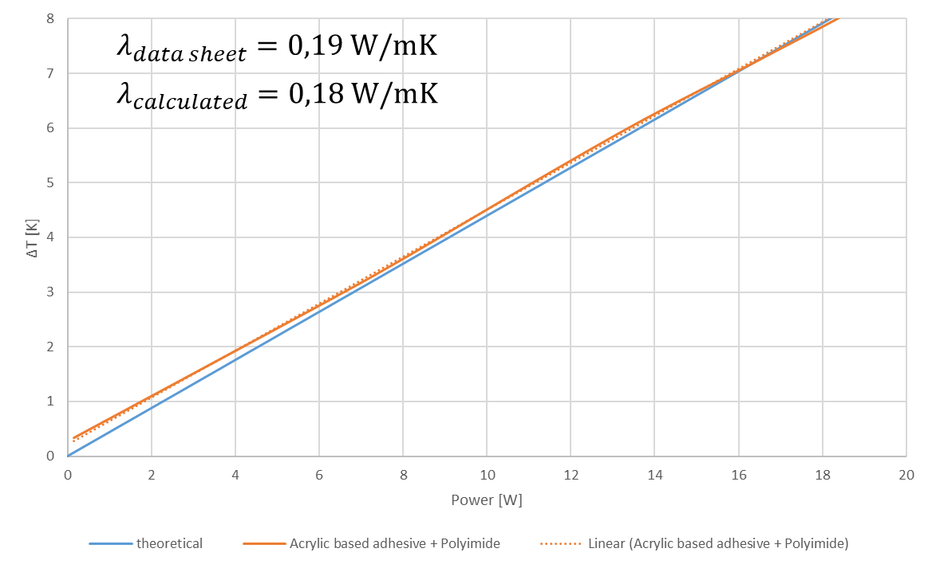
DESIGN OPTIMIZATION: EXPERIMENTAL RESULTS

Slide 14
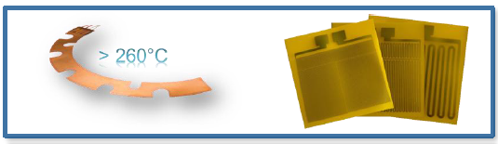
EXTREME OPERATIONAL ENVIRONMENTS
The heaters are ESCC qualified to operate in a temperature range that can vary from -65°C to +200°C.
Currently, ZIHEThas completed the internal qualification of a new product, capable of reaching even higher temperatures (+260°C).
Ongoing:
→ ESCC qualification of the new heater «PPH PurePolyimide»

Slide 15
RESISTENCETO EXTREME ENVIRONMENTS
The ZIHET heaters are qualified to operate in a temperature range that can range from -65°C to +200°C.
Molecules of water released by the MLI after the launch had settled on the mirror behind the main optics, decreasing their visibility by approximately 15%.
ZIHET heaters were turned on to warm it up from −147 °C to −113 °C in about 100 minutes, reaching a temperature high enough for the ice to sublimate, and restoring the instrument’s full functionality.
Recently (March 2024), we have received a confirmation that ZIHET heaters can support even more extreme missions and conditions.
In fact, they have been used to restore the functionality of the main mirror of Euclid.
Artistic Rendering of Euclid in space. Credit: ESA

Slide 16
HIGH RELIABILITY MATERIALS
Materials used in space-qualified flexible heaters must be highly reliable and resistant to space conditions. All materials used must meet high quality standards and comply with ESA and EU regulations.
In this regard, the ZIHET's Purchasing & Supply departments work in close cooperation with the Quality managers in order to ensure the correct quality of the raw materials.
This aspect has been particularly critical during the most recent periods, especially due to the absence of a qualified European production chain for Kapton-FEP variant insulation, while non-European suppliers do not always guarantee standards in line with ESCC.
ZIHET has initiated several collaborative discussions with ASI and ESA in order to create synergies and foundations for developing a European supply chain for such important and critical materials.

Slide 17
TESTING AND QUALIFICATION
In addition to ESCC qualified flexible heaters, ZIHET also offers levels of more commercial qualifications, such as QM (Qualification Model) and PFM (Proto-Flight Model), which ensure compliance for in-flight use, while allowing faster response times and market competitiveness, in order to satisfy all possible needs of the vast market of the New Space Economy, ranging from institutional, military or commercial programs, to Cubesats, Nanosats or Constellations, up to ground test facilities.

Slide 18
TIME TO MARKET
Satellites and space systems of the New Space Economy are increasingly driven by fast and budget-conscious practices.
Beyond customized products, ZIHET provides also a wide range of standard flexible heaters, available in our warehouse in different sizes and ohmic values, as immediate commercial solutions (COTS) for commercial applications and test equipment.
The standard heatersare available for immediate delivery.
They are offered in both versions ESCC (FM) and QM
If the size or shape of the heatsink are not compatible with the use of a single standard heater, the user can cover the surface with a mosaic configuration, connecting multiple heaters in parallel.

Slide 19
INNOVATION AT THE CORE
Addressing these technological challenges requires in-depth knowledge of space requirements and advanced engineering skills in flexible heater design and space system integration.
ZIHET can count not only on its sector experience, but also on the vast multi-sector experience in domestic markets, automotive, transportation, commercial and industrial.
ZIHET invests in research and development to continuously improve the performance and reliability of its products, by having a department R&D specializing in material properties, control electronics and engineering. This team continuously explores new techniques and solutions in all markets, with a continued focus on space compliance.

Slide 20
Growing Together !
zoppasindustries.com
space@zoppas.com
alessandra.marcer@zoppas.com
riccardo.pison@zoppas.com

